Slide 1
Security Implementation Plan
By Jacob Silva

Slide 2

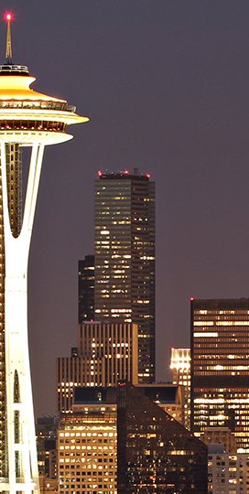
Location Seattle, WA
Safer location from natural disasters
Cheap state of the art power grids
Access to Vancouver, CA and Asia through
the Trans-pacific cables
Close proximity to Silicon Valley

Slide 3
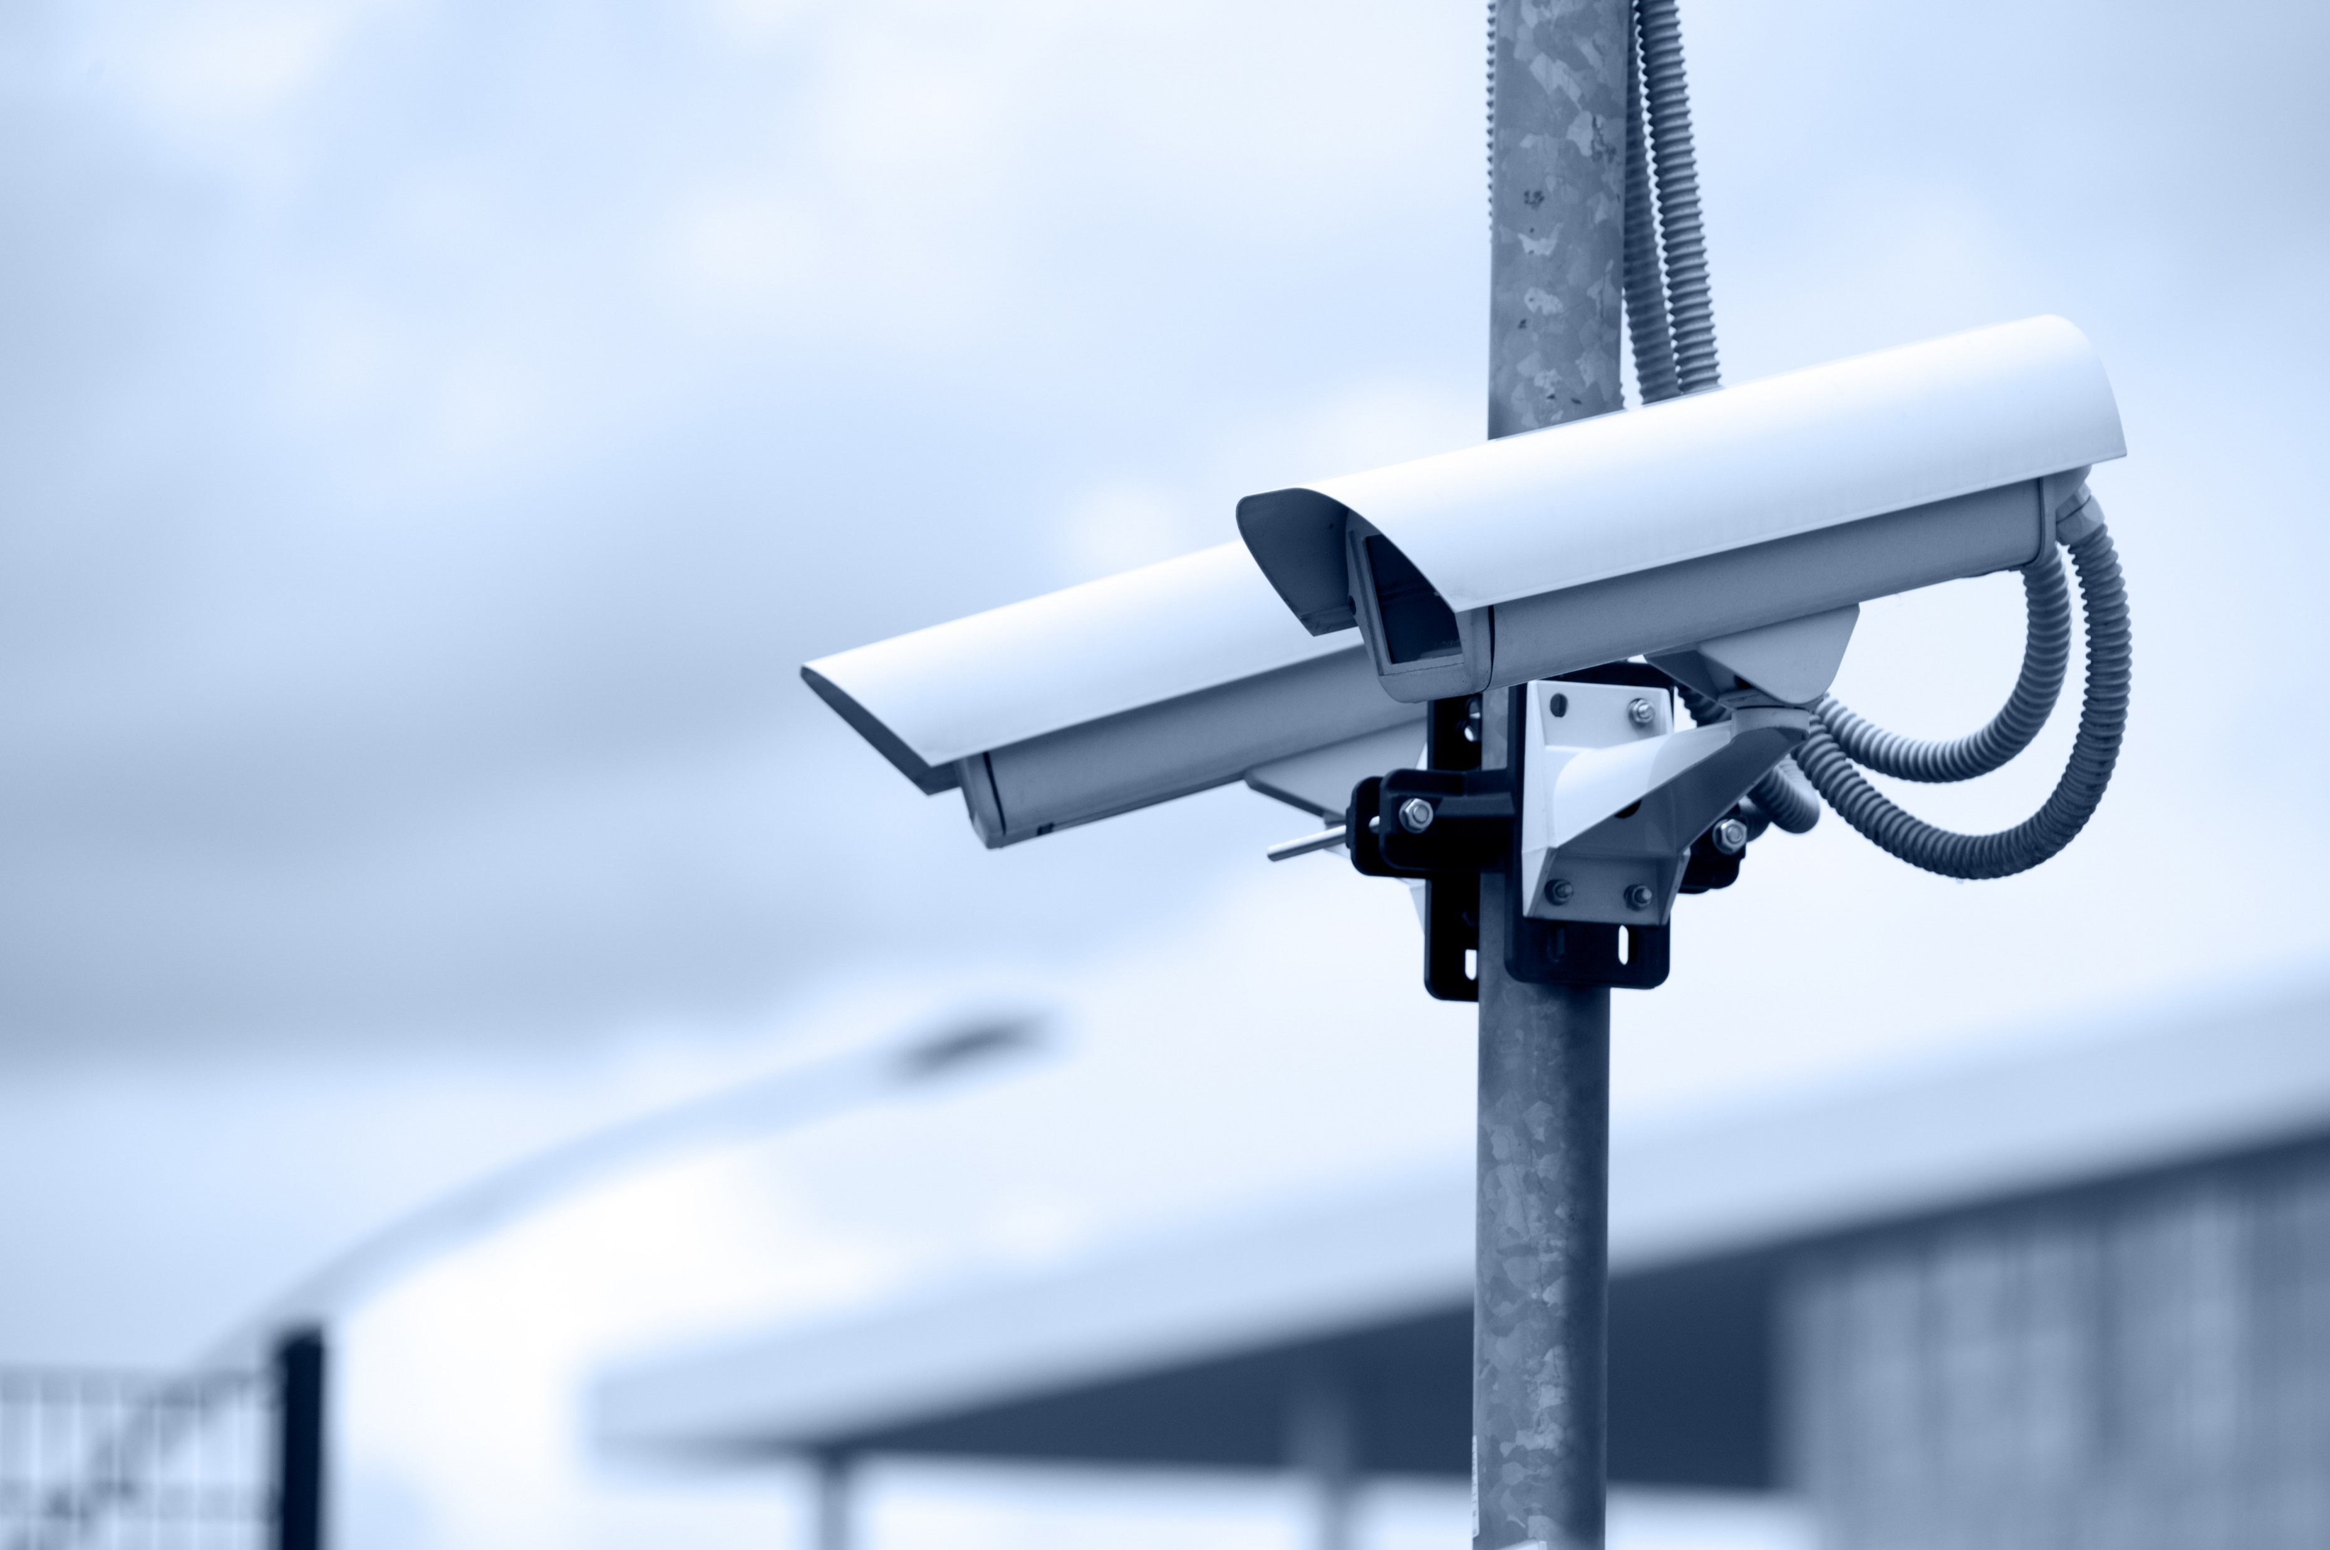
Physical Security
Concrete walls
Use walls lined with Kevlar
100-foot buffer zone
Fenced facility
ID checks at front gate
Security cameras at every angle
Limit entry points
Biometric identification
Security guards to monitor entry points
Various security alarm systems

Slide 4

Internal Security
ID checks in the building
Security cameras at every angle
Emergency exits
Alarms system
Limit entry points
Recirculate air
Monitor critical equipment
Limited windows

Slide 5
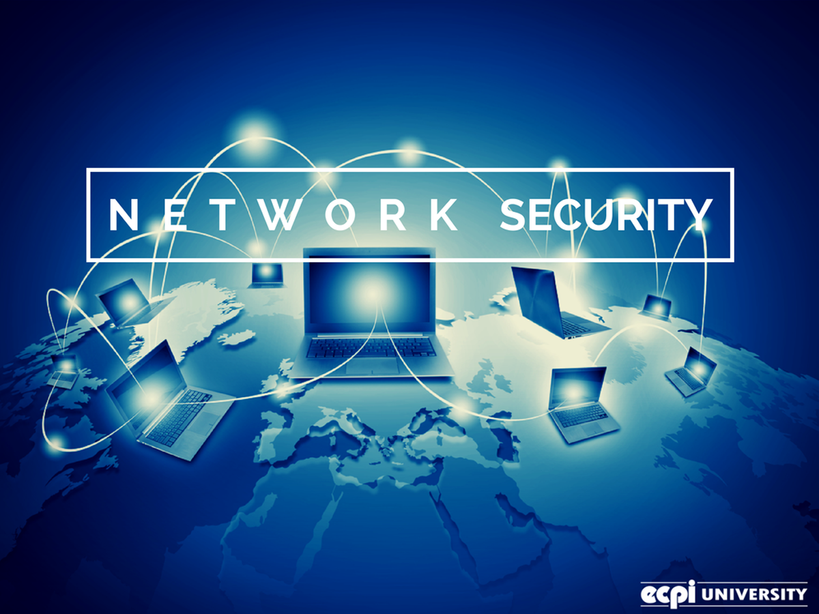
Network Security
Strong passwords
Honeypots
User awareness plan
Intrusion Detection System
Keep our systems up to date
Firewalls
Demilitarized Zone
Vulnerability scanning
Backup systems regularly

Slide 6
Q&A
Q. What happens if the power goes out?
A. Our Uninterruptible Power System will kick in giving us supply of power.
Q. What if there is a bomb threat?
A. Remain calm, notify the authorities and follow appropriate procedures.
Q. What if there is a fire?
A. Remain calm and find the nearest Fire Exit.
Q. What if our servers are compromised?
A. Our specialist's will proceed with necessary measures depending on the compromise.
Q. What if there is data loss or our systems have become corrupted?
A. We will use the backups we have in place if an event like this occurs.
Q. How will we train our users to be cautious of what they do on our system?
A. We will provide a course that all employees are required to take to inform them on proper security habits.

Slide 7
Resources
Jansky, D. (n.d.). Annual Average Electricity Price Comparisonby State. Retrieved April 22, 2018, from http://www.neo.ne.gov/statshtml/204.htm
(n.d.). Retrieved April 22, 2018, from https://www.incapsula.com/blog/choosing-data-center-location.html
Scalet, S. D. (2015, March 31). 19 ways to build physical security into your data center. Retrieved April 22, 2018, from https://www.csoonline.com/article/2112402/physical-security/physical-security-19-ways-to-build-physical-security-into-a-data-center.html
Top 10 Data Center Disasters that could ruin your business... (2015, January 14). Retrieved April 22, 2018, from https://www.teamsilverback.com/top-10-data-center-disasters-that-could-ruin-your-business/
What to Do - Bomb Threat. (2018, March 09). Retrieved April 22, 2018, from https://www.dhs.gov/what-to-do-bomb-threat

