Slide 1

Guide to Using Vulnerability Naming Schemes
(SP 800-51 Rev. 1)
Jacob Silva

Slide 2

Key Terms
Common Vulnerabilities and Exposures (CVE)
Common Configuration Enumeration (CCE)
National Vulnerability Database (NVD)
National Institute of Standards and Technology (NIST)

Slide 3
Common Vulnerabilities and Exposures (CVE)
A globally unique name to identify every vulnerability
MITRE Corporation (Oversees CVEs)
A setup for prioritizing risks of the vulnerabilities
A method for users of products and services to use vulnerability information
A list of publicly known software vulnerabilities
A purpose is to provide a standard to reference known vulnerabilities
Sample CVE RealMedia server:
CVE ID: CVE-2000-0001
Description: RealMedia server allows remote attackers to cause a denial of service via a long ramgen request.
References: BUGTRAQ: 19991222 RealMedia Server 5.0 Crasher (rmscrash.c)
URL:http://www.securityfocus.com/bid/888XF:realserver-ramgen-dos

Slide 4
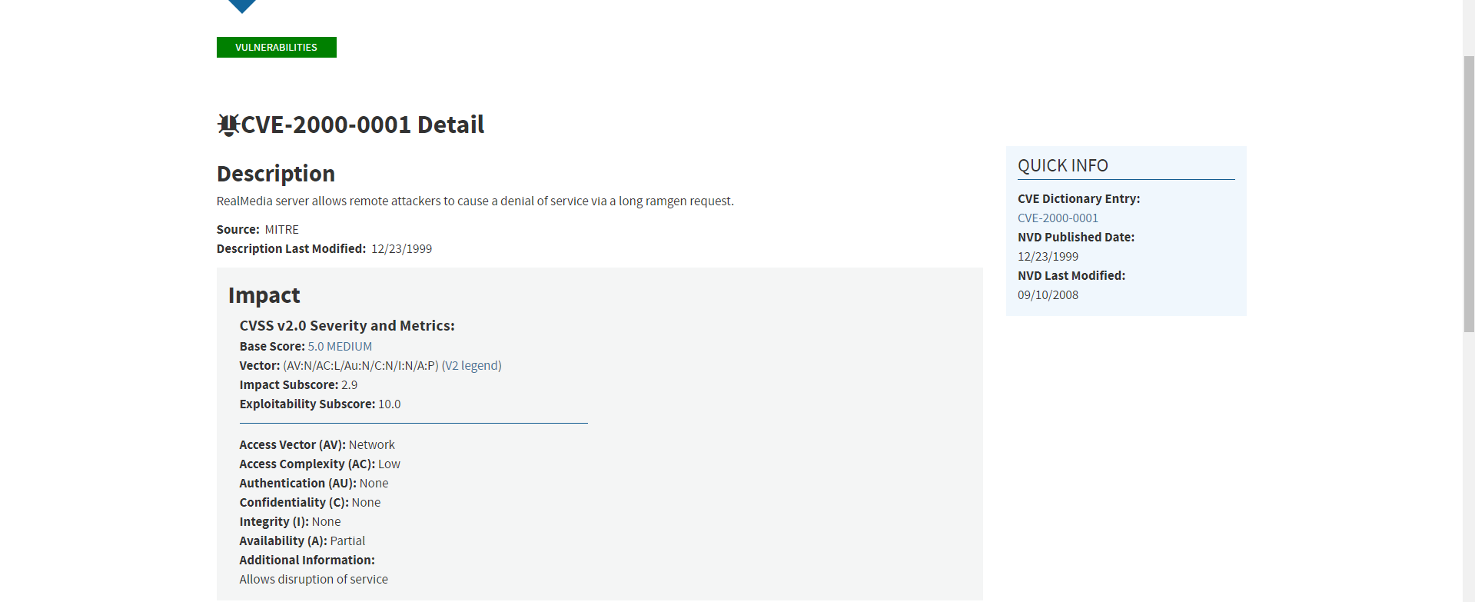
nvd.nist.gov/vuln/detail/CVE-2000-0001
Ex: CVE-2000-0001

Slide 5
Common Configuration Enumeration (CCE)
Naming scheme for dictionary of software security configs
Every security config issue is given a unique identifier
The attributes of a CCE is a unique id number, descriptions of the configuration issue, parameters of the CEE, associated technical mechanisms related to the CCE, and any references to additional sources of information
Purpose is to provide a standard to reference known configuration issues
Sample CCE Windows XP Telnet:
CCE ID: CCE-3108-8
Description: The correct service permissions for the Telnet service should be assigned.
Parameters: (1) set of accounts (2) list of permissions
Technical
Mechanisms: (1) set via Security Templates (2) defined by Group Policy
References: Listed at http://cce.mitre.org/lists/cce_list.html

Slide 6
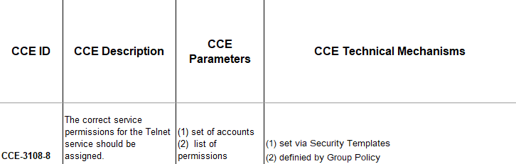
Ex: CCE-3108-8

Slide 7
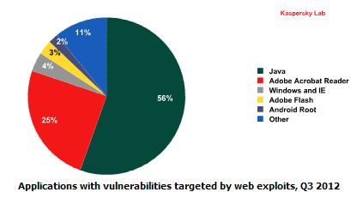
Problems
Software vulnerabilities
Remote attackers leveraging vulnerabilities
  90% of Companies Get Attacked with Three-Year-Old Vulnerabilities
Updates Required
  People neglect updates
Company secrets being targeted
  Some Foreign nations are known to steal Intellectual Property
Company down time
  Breaches come with a lot of problems possibly resulting in company downtime

Slide 8
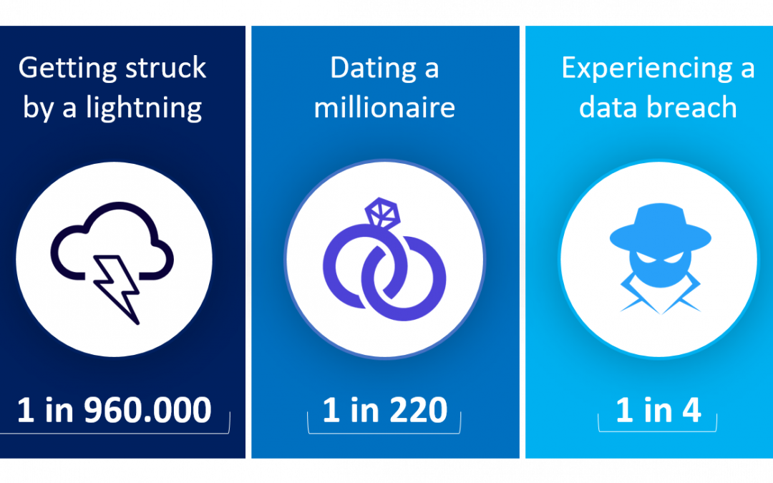
Solution
Regular inspections on our software
  Searching the Internet for CVE’s and CCE’s that are related to the software being used in our company
  IDS/IPS
  Firewalls
Back ups
  Weekly back ups
  Back up integrity checks
Utilize Pentester firms to demonstrate and document flaws in security every 6 months
  Price estimates $50,000 yearly
Update when necessary
  Updates are necessary to patch security issues with software we use

Slide 9

Summary
Common Vulnerabilities and Exposures (CVE)
Common Configuration Enumeration (CCE)
People with motives
Windows updates
Software updates
Backups
Firewalls
IDS/IPS

Slide 10
Sources
Waltermire, D., & Scarfone, K. (n.d.). Guide to Using Vulnerability Naming Schemes. Retrieved April 15, 2019, from https://nvlpubs.nist.gov/nistpubs/Legacy/SP/nistspecialpublication800-51r1.pdf
Vulnerability Metrics. (n.d.). Retrieved April 15, 2019, from https://nvd.nist.gov/vuln-metrics/cvss
Common Configuration Enumeration (CCE) Details. (n.d.). Retrieved April 15, 2019, from https://nvd.nist.gov/config/cce/index
How Much Does a Pentest Cost? (n.d.). Retrieved April 16, 2019, from https://www.securitymetrics.com/blog/how-much-does-pentest-cost
Cimpanu, C. (2017, August 24). 90% of Companies Get Attacked with Three-Year-Old Vulnerabilities. Retrieved April 16, 2019, from https://www.bleepingcomputer.com/news/security/90-percent-of-companies-get-attacked-with-three-year-old-vulnerabilities/

